Slide 1
Class Project – Bridge Pattern
CS665 Summer 2018
Nick Cuneo
Notes:
Hello, my name is Nick Cuneo and I will be presenting to you a little bit on the bridge design pattern I used in my class project.

Slide 2
What is the bridge pattern?
Ability to decouple abstraction and implementation
Runtime creation of content
Separate class hierarchies
Notes:
The bridge pattern is a creational design pattern which allows you to create dynamic bindings at runtime. It is similar in nature to the adapter pattern, however it is used to allow two hierarchies to act independent of each other. For my class project, I decided to solve this problem using a real world case that would benefit from this design pattern, and that is application skinning.

Slide 3
Poor Design
Page
GreenBlogPage
LightBlogPage
LightHomepage
DarkHomepage
GreenHomepage
DarkBlogPage
Notes:
For instance, if we wanted to have an application which supported a light and dark theme, one could consider a design such as this. As you can see, each time you add a new theme or a new page, we would need to create several new classes. This is not maintainable. If we wanted to add a new page and theme, we would need to add every combination of page and theme. This is where the bridge pattern comes into play

Slide 4
Bridge Pattern
Page
Theme
Homepage
LightTheme
BlogPage
DarkTheme
Notes:
The bridge pattern allows us to split the class hierarchies between themes and pages. This gives us the ability to allow each area to concentrate on functionality only relevant to itself. When a page is rendered it simply queries which theme is currently applied, and gets the style sheet to apply to itself. Now when we go to add a new page and a new theme, we are only adding one class for each, rather than adding one class for each combination of theme and page.

Slide 5
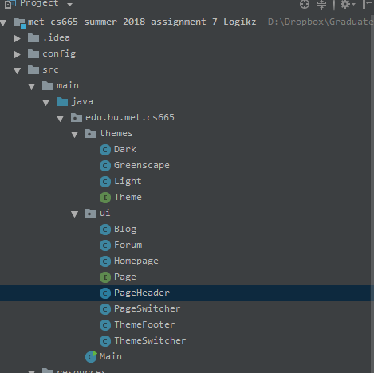
Assignment
Notes:
If we take a look at our assignment, we will see that we have broken Theme and Page hierarchies out into two packages. This gives us flexibility to add new pages and themes quite easily.

Slide 6
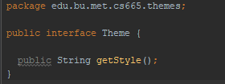
Theme Interface
Notes:
The theme interface is quite simple, as it provides an API to retrieve the theme to apply. This application is using JavaFX which supports CSS. So this API returns a CSS file which can be applied to our application to change the look and feel of the page we are on.

Slide 7
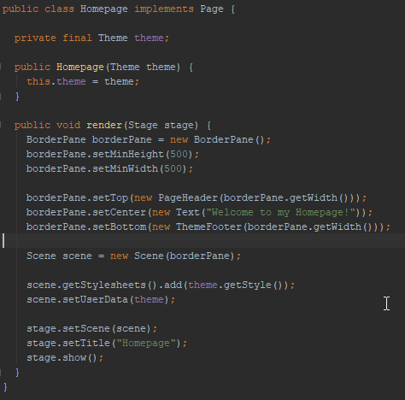
Page Implementation
Notes:
Here we have an example of a page, which is constructed using a theme. When the page is rendered, the getStyle api is called to retrieve the skinning file to apply to the application.

Slide 8
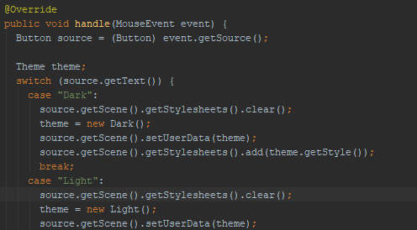
Switching Themes
Notes:
Switching themes is supported when a button is clicked to change the theme. We find out which button was clicked, and create a new theme instance and apply the theme to the style sheet. We also set the metadata of the scene to the style so we can retrieve the style when we render a new page. This gives us a mechanism to save some state on the application.

Slide 9
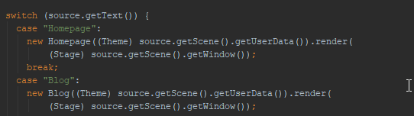
Switching Pages
Notes:
Switching pages is as easy as retrieving the state of which skin we are on, and initializing a new page with that theme to render.

Slide 10
Demo!

